Slide 1
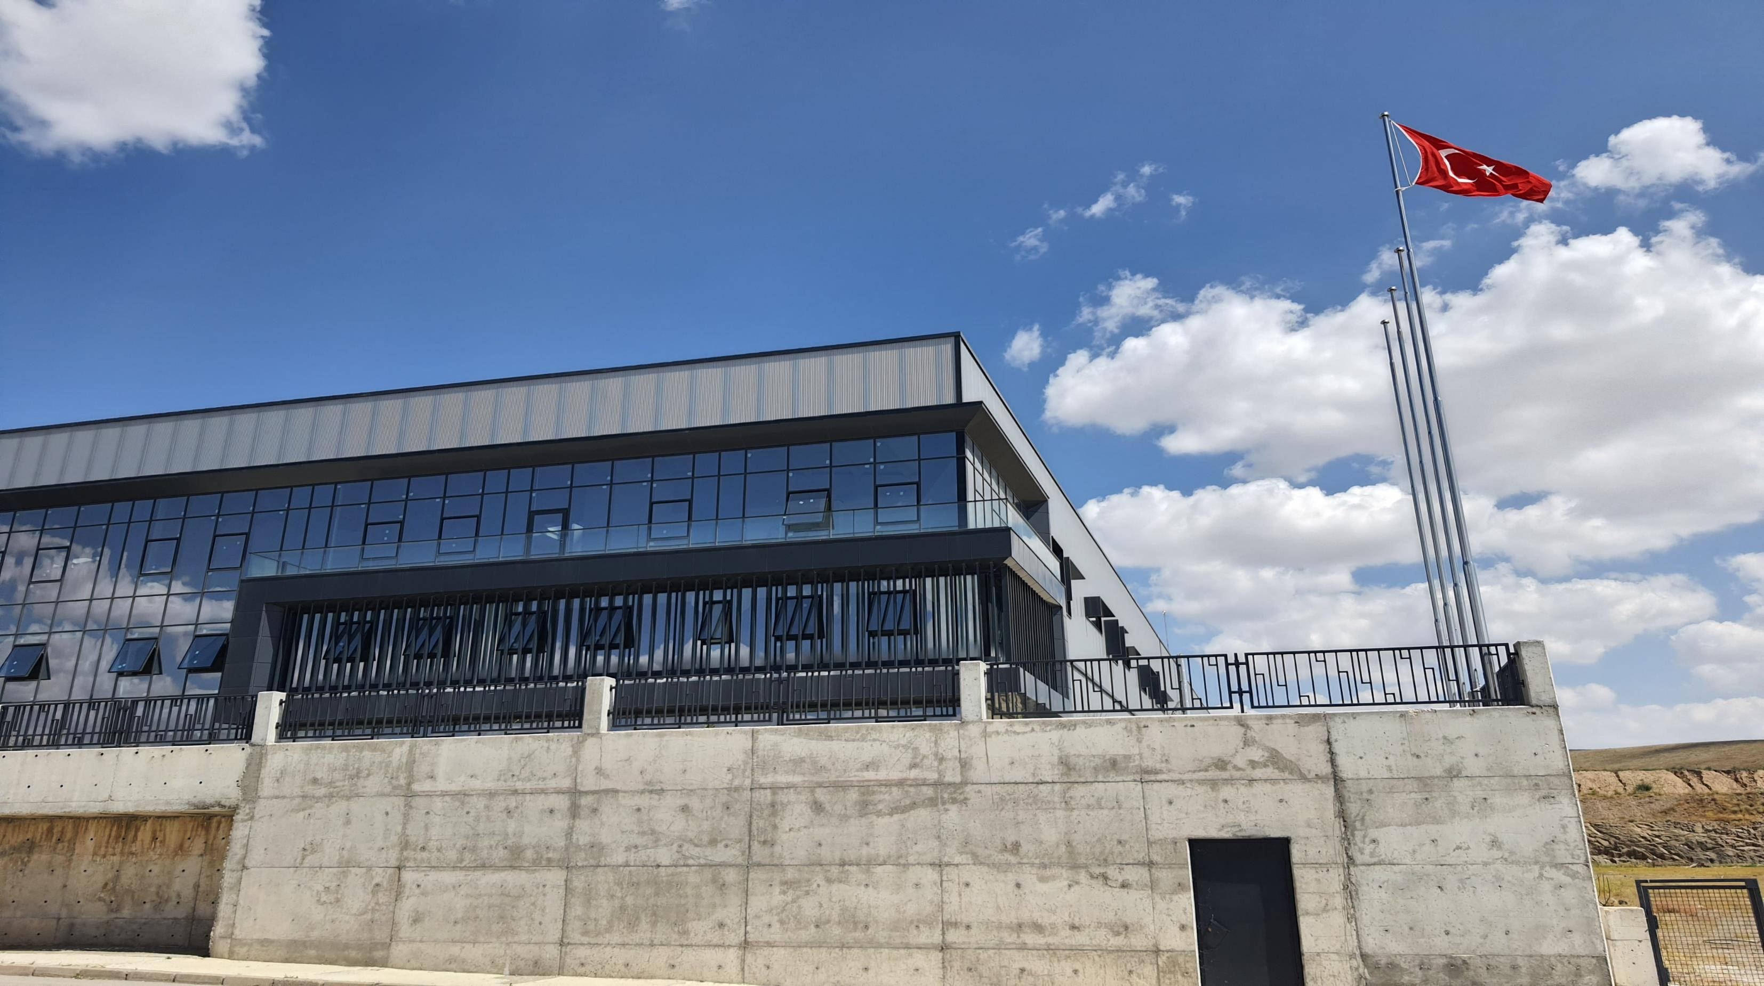

INNOVATING Healthcare
EmpowerIng LIFE
Company Profile

Slide 2
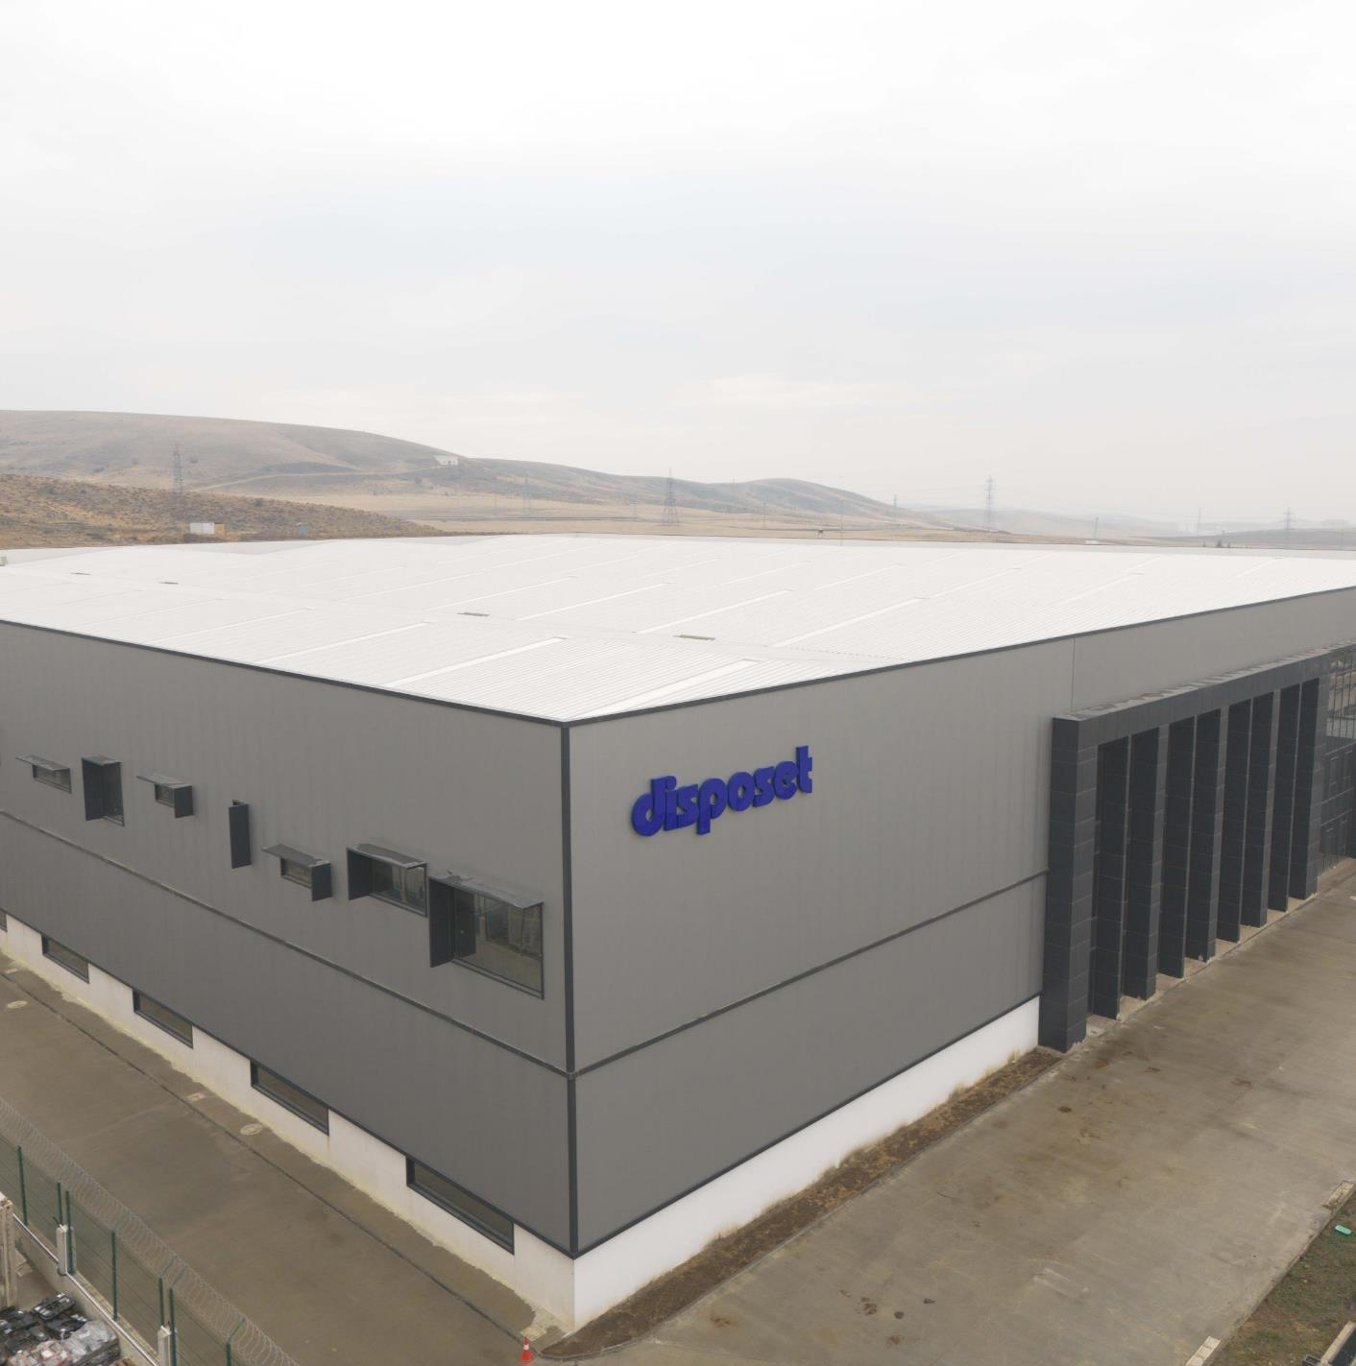

ABOUT DISPOSET
Founded in 2003, DISPOSET focuses on enhancing the quality of healthcare services by providing
advanced technological cardiopulmonary care,
products in the fields of ECLS, intensive care,
emergency services, and respiratory care.
Industry requirements are met through a continuous commitment to high standards in its products.
Based in Ankara, Disposet serves a broad customer base across Turkey, prioritizing customer satisfaction through dedicated technical support services.

Slide 3

ABOUT DISPOSET
Our Mission
To be a leading company in the healthcare sector with an approach that prioritizes customer satisfaction while emphasizing professionalism and quality. To contribute to the Turkish healthcare system in the fastest and most effective way by keeping up with the latest technology.
Our Vision
To closely monitor developments in the healthcare sector and be a market leader by offering innovative, high-quality products tailored to industry needs. To achieve growth through strategic investments and decisive actions, thereby increasing our market share. To provide long- term, sustainable services built on quality and trust.

Slide 4
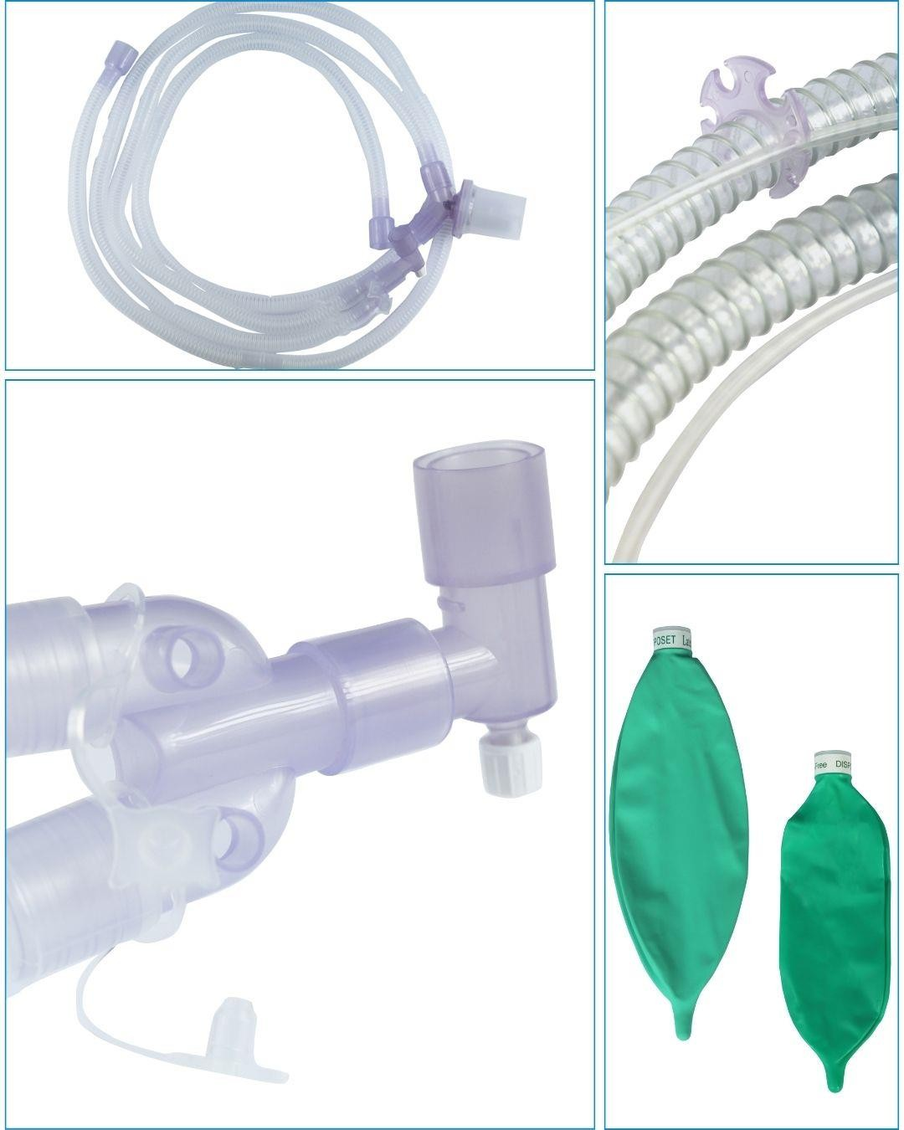



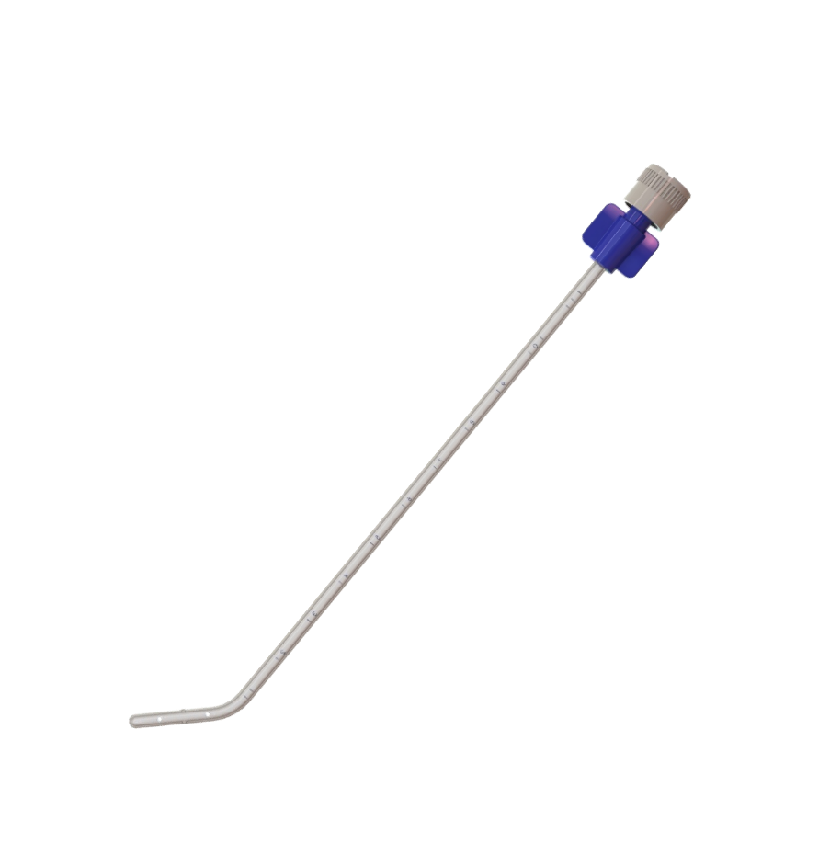


PRODUCT GROUPS
Anesthesia & Breathing Systems
Anesthesia & Breathing Circuits with Corrugated Tubing
Anesthesia & Breathing Circuits with Smoothbore Tubing
Anesthesia & Breathing Circuits with Extendable Tubing
Anesthesia & Breathing Circuits with Limb-O Tubing Breathing Circuits with Heated Wire
Transport Ventilator Breathing Circuit
Accessories
  Breathing Filter
  Heat & Moisture Exchanging Breathing Filter (HMEF)
  Anesthesia Breathing Bag
  Catheter Mount
  Anesthesia Mask
  Humidification Chamber
  Gas Sampling Line
  Connector
  Water Trap
  Tubing
  Head Band for Mask
Surfactant Administration
  Surfactan Catheter

Slide 5
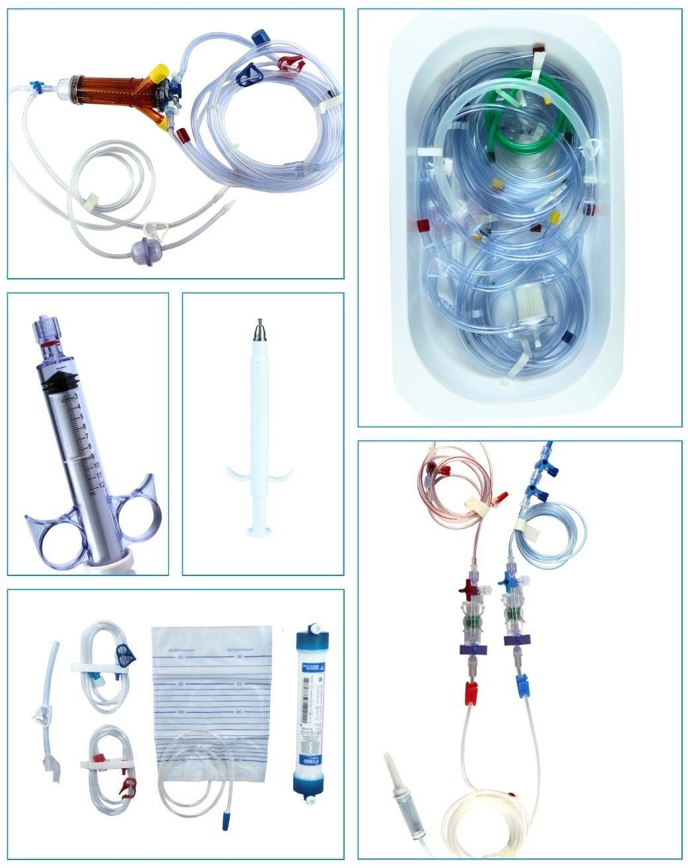






PRODUCT GROUPS
Cardiovascular Surgery & Cardiology
Extracorporeal Tubing Set
Cardioplegia Set
Hemofiltration Set
Aortic Punch
Tourniquet Set
Cardioplegia Adapters
Cardiac Connectors Oxygenator Temperature Probe
Level Sensor Holder
Tubing Set Organizer
Manifold Set
Infusion
Gravity Set and Pump Set
Extension, Pressure and Perfusion Line
Pressure Monitoring
  Wired and Wireless Pressure Monitoring
  Closed Blood Sampling System
Oncology
  Chemotheraphy Preparation and Delivery Set

Slide 6




DISPOSET DISTRIBUTORSHIPS
Domestic

Slide 7
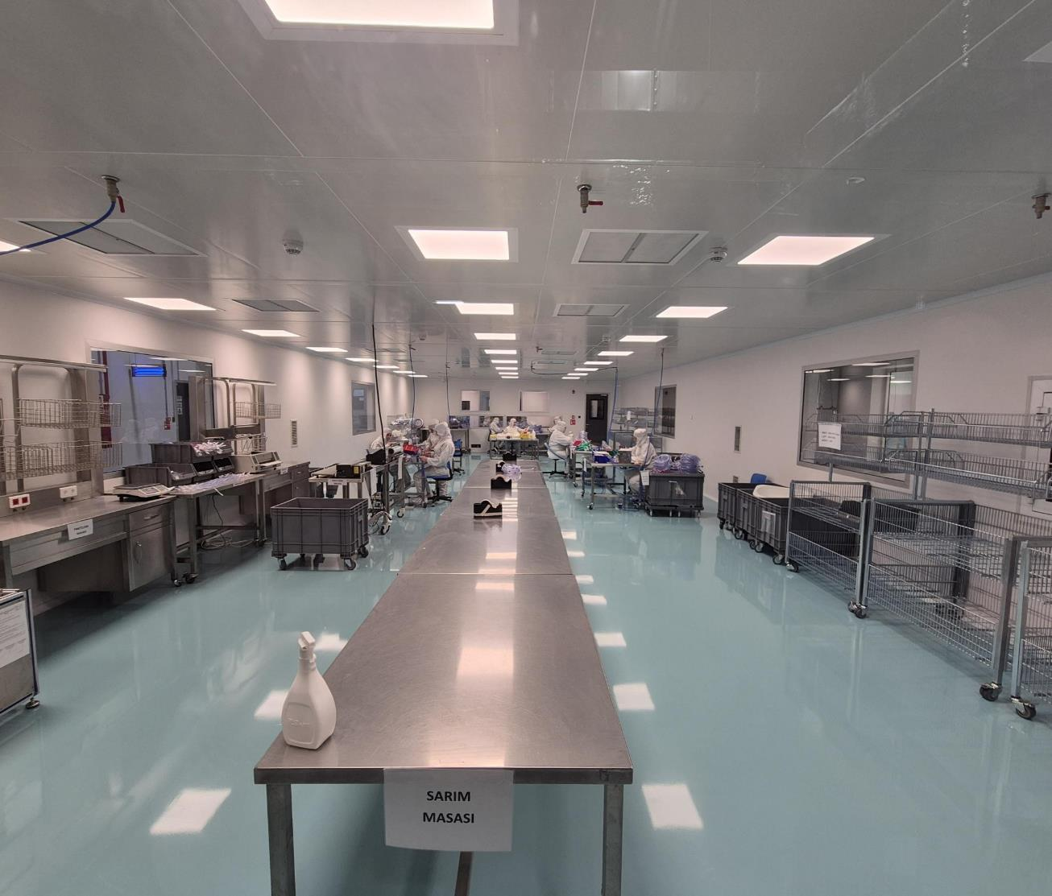


PRODUCTION FACILITIES
Manufacturing Facilities
Total area of 19,000 m², with 5,000 m² for production and 2,500 m²
for cleanroom facilities, employing over 100 people.
Compliance Standards
Facilities adhere to ISO 14644-4, ISO 14698, EN ISO 13485: 2003 Medical Device Quality Management System, and GMP standards.
Cleanroom Operations
Product assembly and packaging are performed in Class ISO 8
cleanrooms, covering a total area of 2,500 m² across 5 rooms.
Controlled Processes
Extrusion and injection processes are conducted in a controlled area.

Slide 8
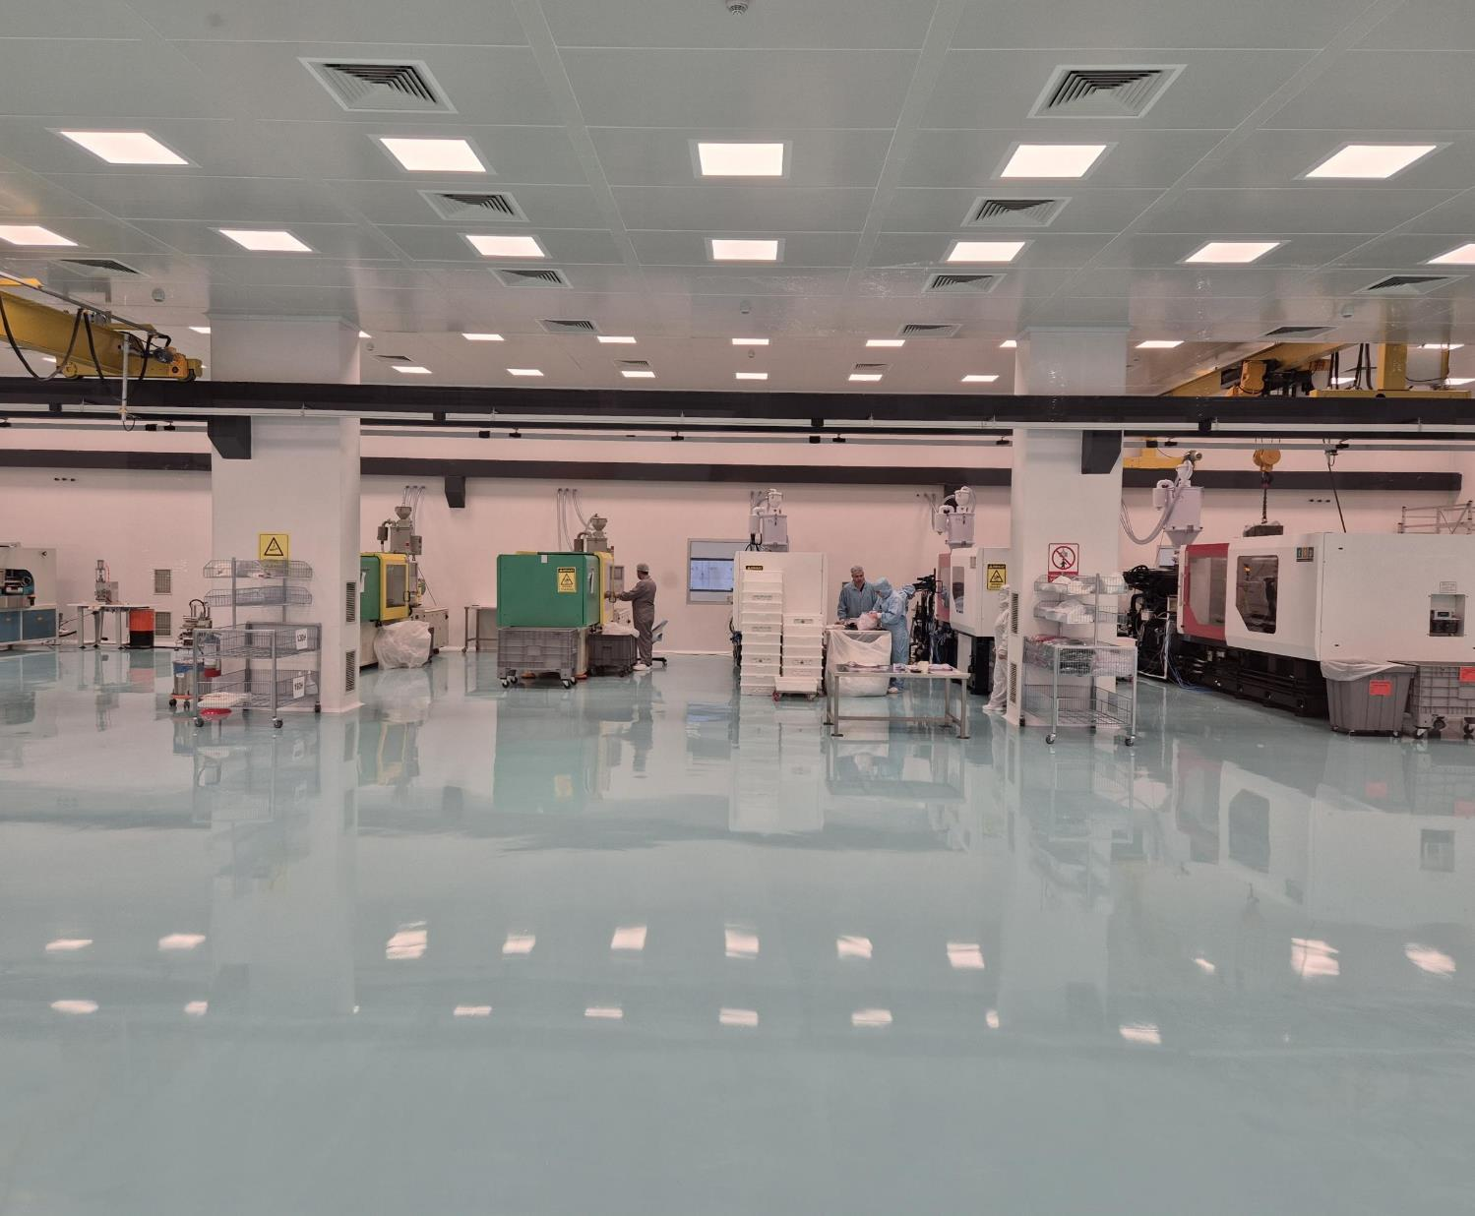

TECHNOLOGY AND INNOVATION
OEM Manufacturing
Currently serving diverse range of markets, including Italy, Sweden, France, Argentina, Slovenia, Russia, the United Kingdom, and Germany, delivering high-quality OEM solutions tailored to the unique needs of
each market.
Ongoing R&D Projects
More than 7 active research initiatives underway, with 2 currently in the certification phase, advancing technology and driving progress in the industry.
Total Molds Available
Over 110 molds in stock, with the capability to produce a wide range of high-quality molds tailored to specific needs, ensuring flexibility and efficiency.

Slide 9
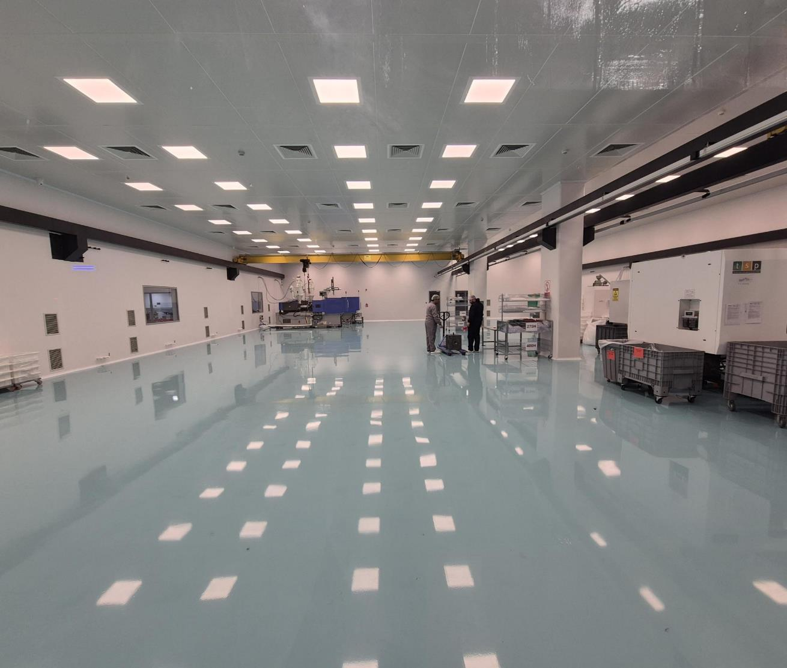

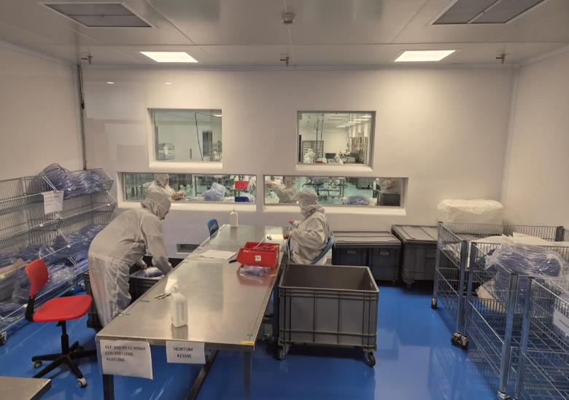

QUALITY MANAGEMENT SYSTEM
High-Quality and Standard-Compliant Production Disposable medical devices are manufactured using validated processes and high-quality packaging materials.
Biocompatibility and Material Standards
Biocompatible raw materials used in production comply with ISO 10993 standards.
Waste Management System
A comprehensive waste management system, ensuring hazardous and non-hazardous wastes are responsibly stored and delivered to certified recycling companies for proper disposal and recycling.

Slide 10
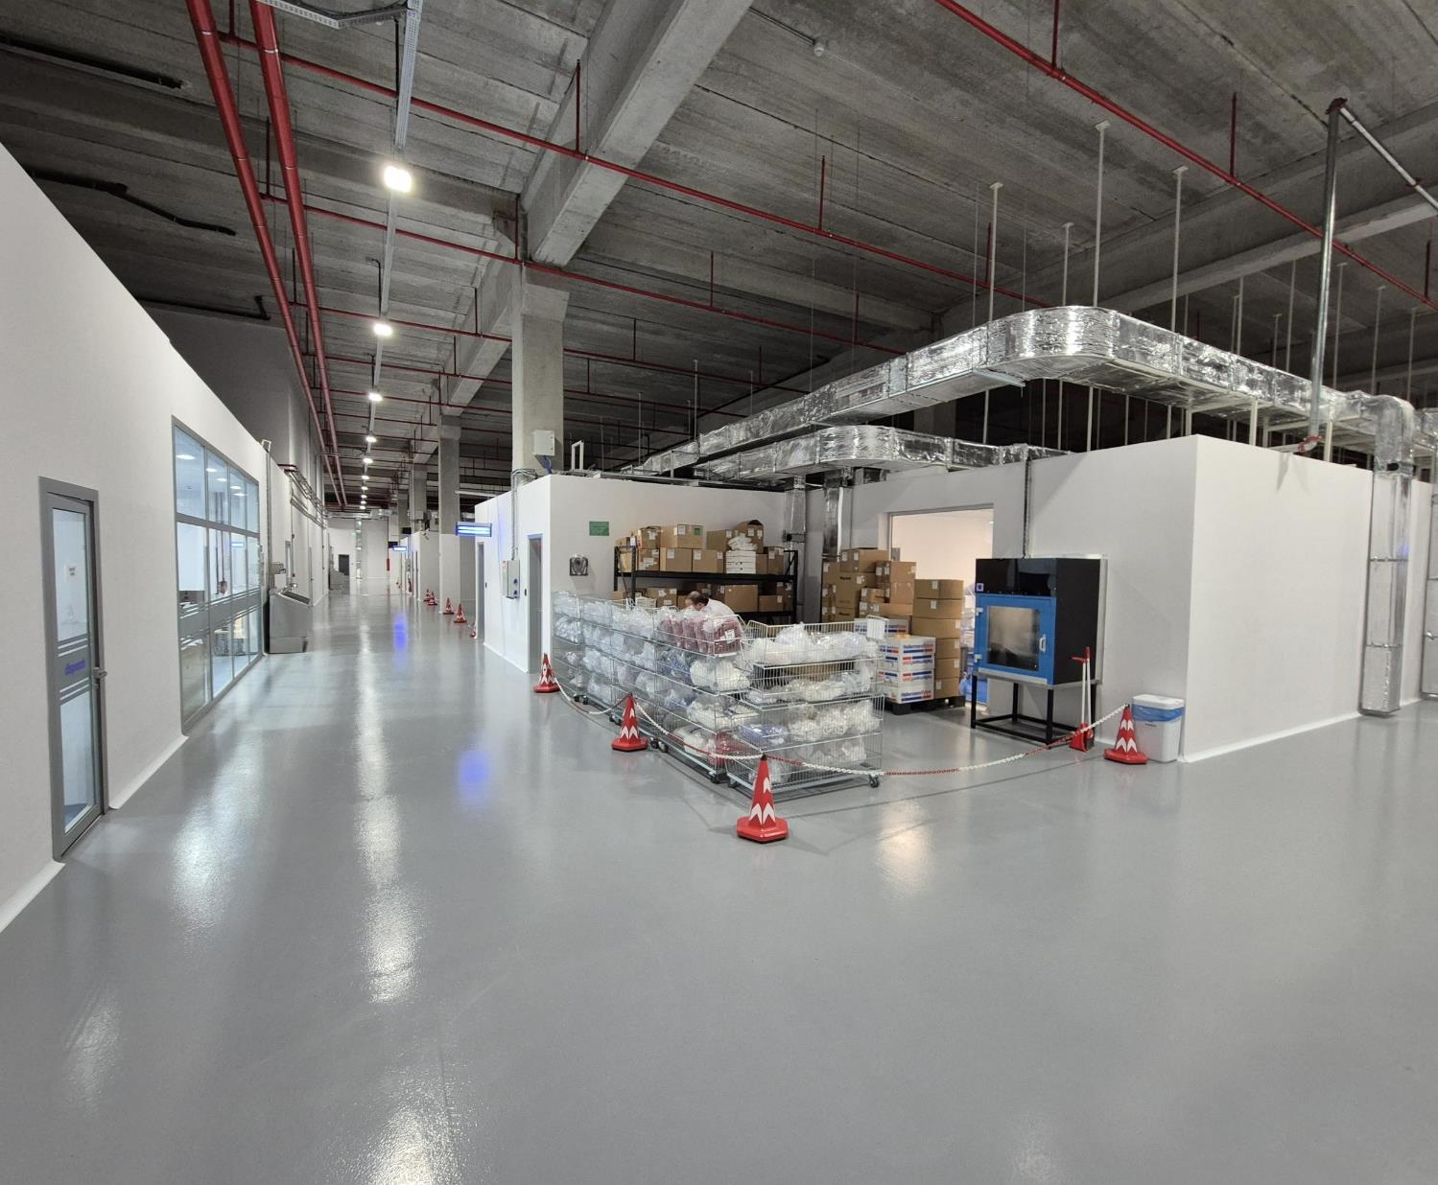


QUALITY MANAGEMENT SYSTEM
Quality Management System
All products bear the CE mark, demonstrating compliance with the Medical Device Directive 93/42/EEC.
Quality Management System is certified according to ISO 13485:2016.
New Medical Device Regulation - MDR
Compliance process is being carried out with a dedicated team fully focused on this matter.

Slide 11
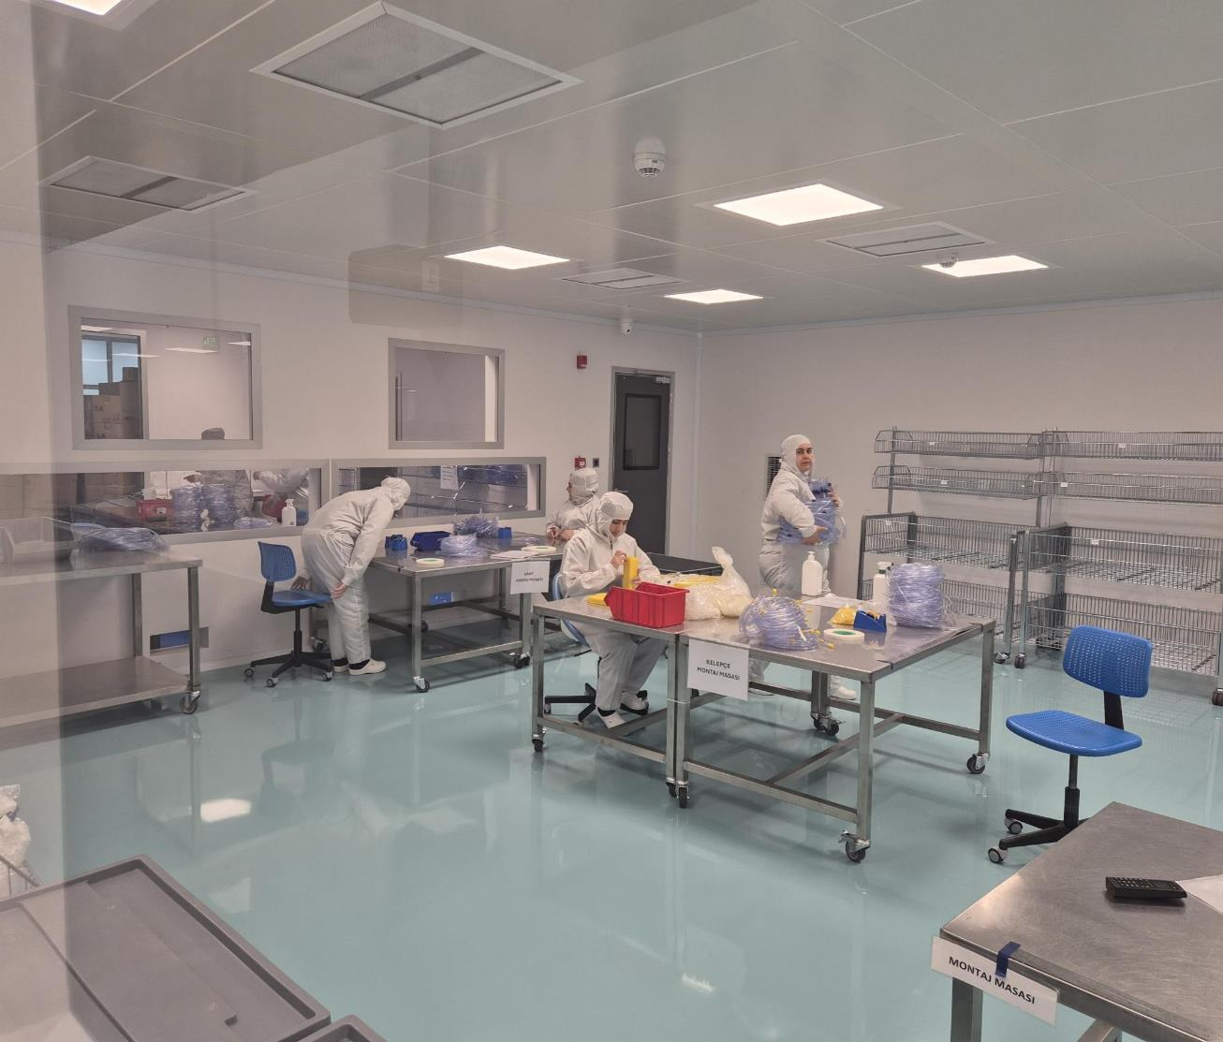

QUALITY CONTROL PROCESSES
In-House Acceptance Quality Control
Ensuring all materials and products meet the stringent requirements of the quality management system.
Incoming and Outgoing Inspections
Every item is thoroughly controlled before entering and leaving the factory.
Process and Product MonItorIng
Rigorous controls are applied at every stage, including injection, extrusion, and the assembly of circuits and semi-finished products.

Slide 12
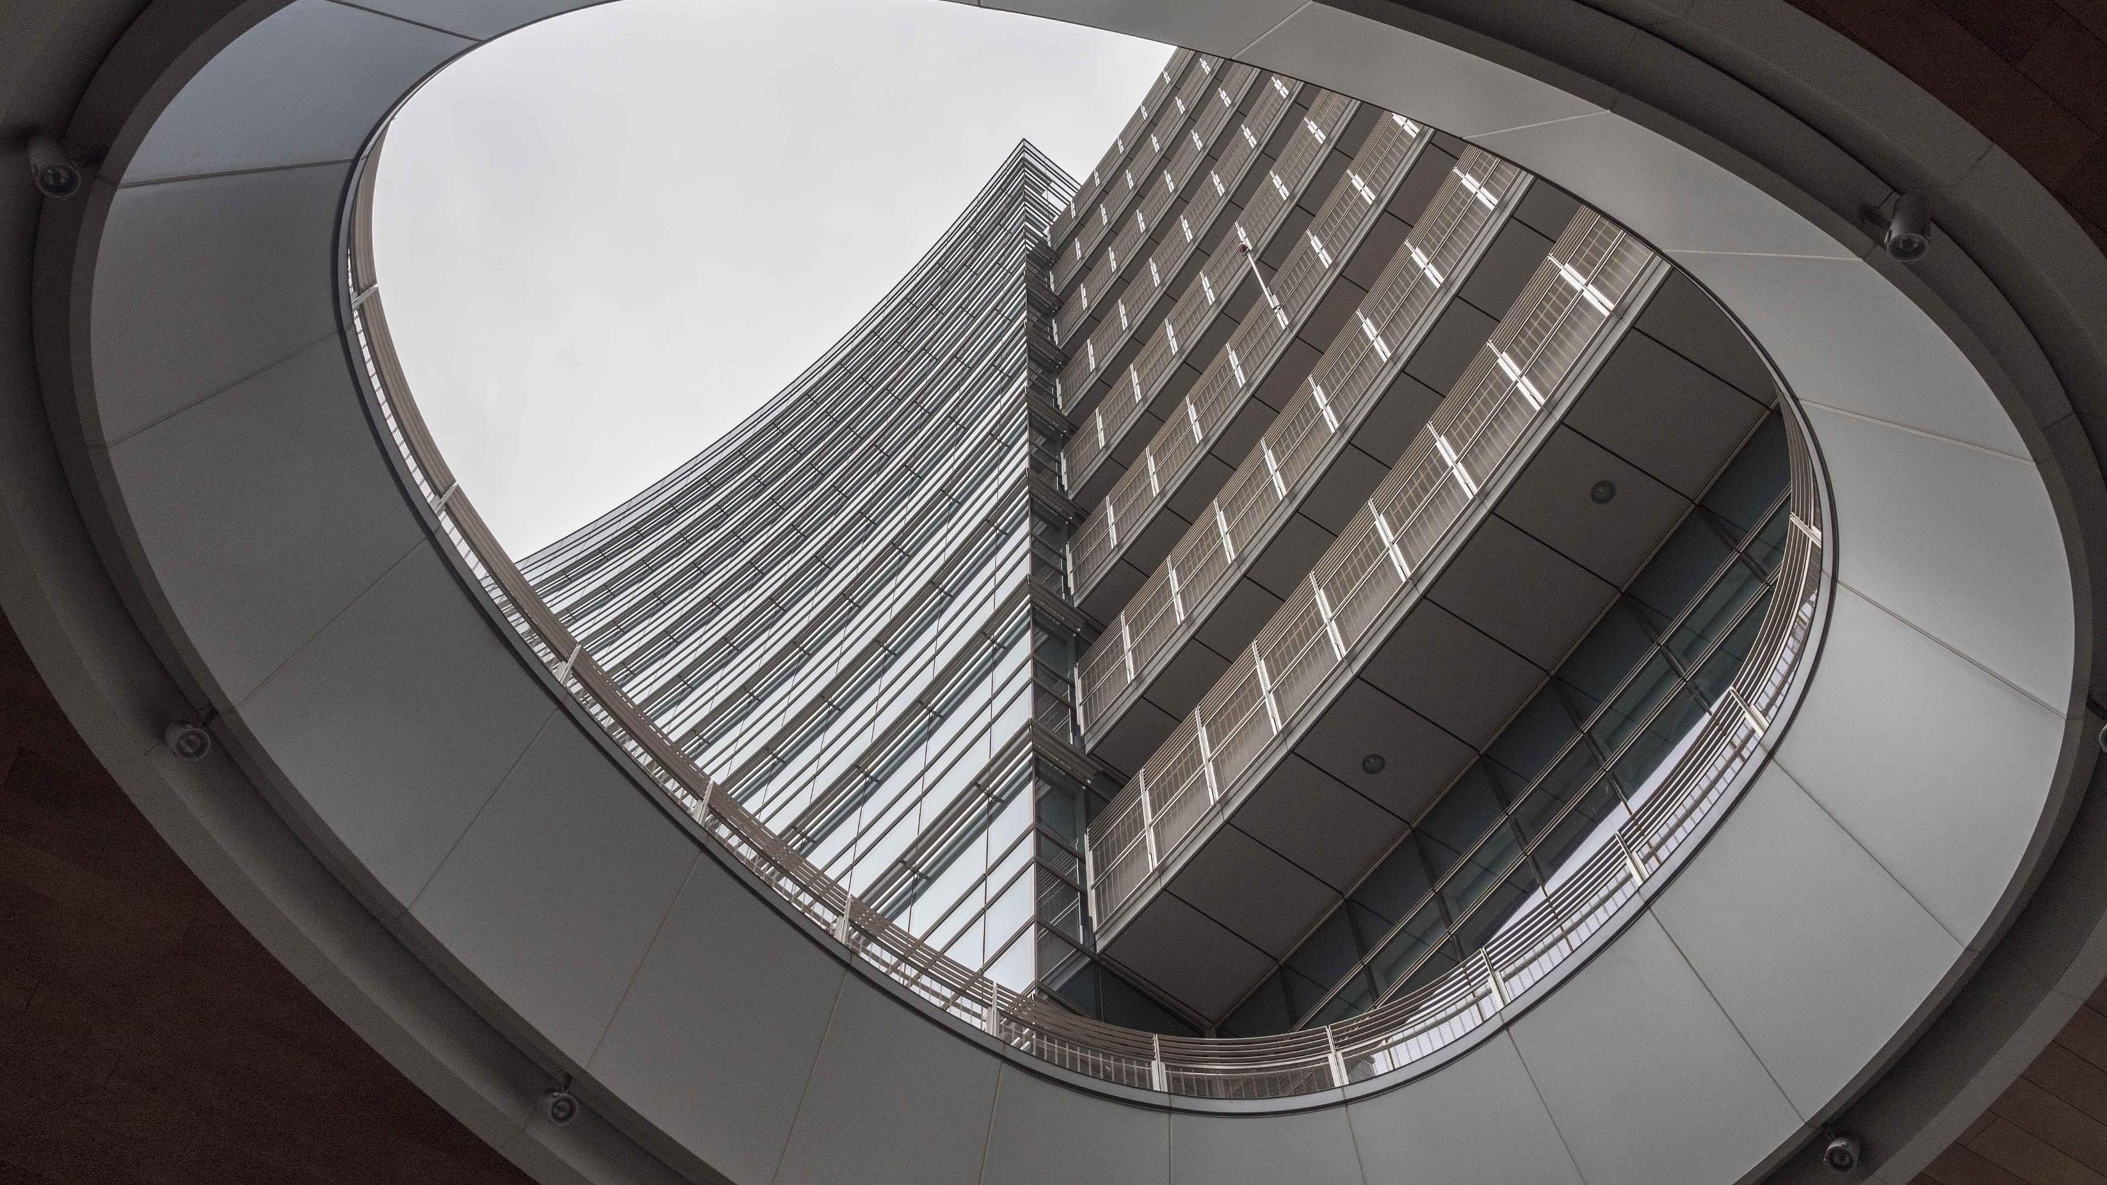

Thank you for your collaboratIon

